Slide 1
INF10025
Data Management and Analytics
Week 02 – Part 3
Forms, Indexes

Slide 2
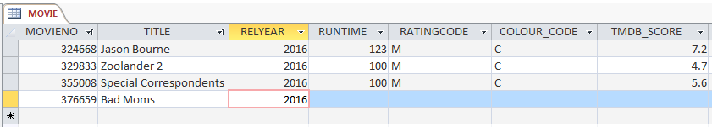
Adding a new record to the Movie Table
Last lecture we created a Movie table. To add a new movie we:
  Open the Movie Datasheet view
  Click on the * at the bottom left of the view
  Type in the details
The Datasheet view:
  Not end-user friendly. You would not expect end-users/customer to use a datasheet.
  If this was an employee table, it would contain personal details. The end-user could see data about other employees
  Easy to delete data in one row / multiple rows very easily (by mistake)

Slide 3
The Movie Table
The Movie table has a field called RatingCode.
What is a "PG" rated movie?
  RatingName: "PARENTAL GUIDANCE"
  Description: "Parental guidance recommended for persons under 15 years."
What is a "MA" rated movie?
  RatingName: "MATURE ACCOMPANIED (15+)"
  Description: "Persons under 15 years must be accompanied by a mature adult."
movieNo | title | relyear | runtime | ratingcode
15 | The Hunger Games | 2012 | 142 | PG
41 | Silver Linings Playbook | 2012 | 122 | MA
135 | The Hangover | 2009 | 100 | MA
156 | X-Men Days of Future Past | 2014 | 101 | PG

Slide 4
Too much in one table
Imagine, we add rating details to the Movie table
movieNo | title | relyear | runtime | ratingcode | ratingName | ratingDescription
15 | The Hunger Games | 2012 | 142 | PG | PARENTAL GUIDANCE | Parental guidance recommended for persons under 15 years
41 | Silver Linings Playbook | 2012 | 122 | MA | MATURE ACCOMPANIED (15+) | Persons under 15 years must be accompanied by a mature adult
135 | The Hangover | 2009 | 100 | MA | MATURE ACCOMPANIED (15+) | Persons under 15 years must be accompanied by a mature adult
156 | X-Men Days of Future Past | 2014 | 101 | PG | PARENTAL GUIDANCE | Parental guidance recommended for persons under 15 years
What problems could arise?
Solution: create a separate table for Ratings

Slide 5
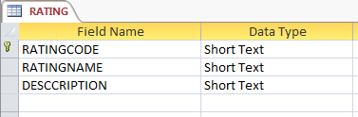
Movies and Rating Codes
This Rating information should be stored in our Database in a Table.
RATINGCODE | RATINGNAME | DESCRIPTION
G | General | Suitable for all ages
PG | Parental Guidance | Recommended for mature audiences 15 years and over
M | Mature (15+) | Persons under 15 years must be accompanied by a mature adult
MA | Mature Accompanied (15+) | Parental guidance recommended for persons under 15 years
R | Restricted (18+) | Restricted to mature adults 18 years and over

Slide 6
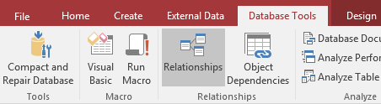
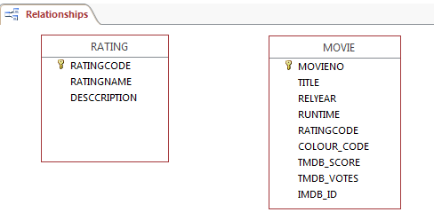

Movies and Rating Codes
When more than one table exists in a Database, we should open
the Relationships Manager
We add the tables to the
manager window

Slide 7
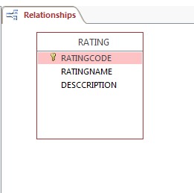
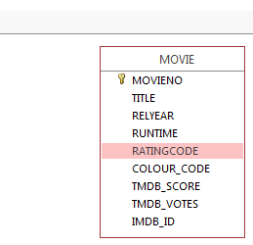
Movies and Rating Codes
There is a connection between Movie and Rating.
Drag the field RATINGCODE in the movie table and drop it over RATINGCODE in the Rating table

Slide 8
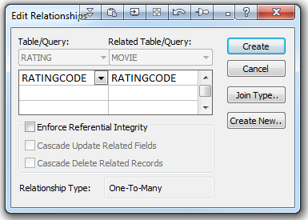
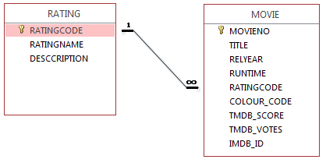
Movies and Rating Codes
This creates a Many to One relationship
The movie.ratingcode field is referred to as
a Foreign Key.
Each Foreign Key value in the Movie
table references a Primary Key value
in the Rating Table

Slide 9
Movies and Rating Codes
Each Foreign Key value in
the movie table
references a Primary
Key value in the Rating
table
movieNo | title | relyear | runtime | Foreign Key ratingcode
15 | The Hunger Games | 2012 | 142 | PG
41 | Silver Linings Playbook | 2012 | 122 | MA
135 | The Hangover | 2009 | 100 | MA
156 | X-Men Days of Future Past | 2014 | 101 | PG
Primary Key ratingcode | RatingName | Description
G | General | Suitable for all ages
PG | Parental Guidance | Recommended for mature audiences 15 years and over
M | Mature (15+) | Persons under 15 years must be accompanied by a mature adult
MA | Mature Accompanied (15+) | Parental guidance recommended for persons under 15 years
R | Restricted (18+) | Restricted to mature adults 18 years and over

Slide 10
Movies and Rating Codes
This is a Many to One
relationship.
Many FKs refer to
one PK.
movieNo | title | relyear | runtime | Foreign Key ratingcode
15 | The Hunger Games | 2012 | 142 | PG
41 | Silver Linings Playbook | 2012 | 122 | MA
135 | The Hangover | 2009 | 100 | MA
156 | X-Men Days of Future Past | 2014 | 101 | PG
Primary Key ratingcode | RatingName | Description
G | General | Suitable for all ages
PG | Parental Guidance | Recommended for mature audiences 15 years and over
M | Mature (15+) | Persons under 15 years must be accompanied by a mature adult
MA | Mature Accompanied (15+) | Parental guidance recommended for persons under 15 years
R | Restricted (18+) | Restricted to mature adults 18 years and over

Slide 11
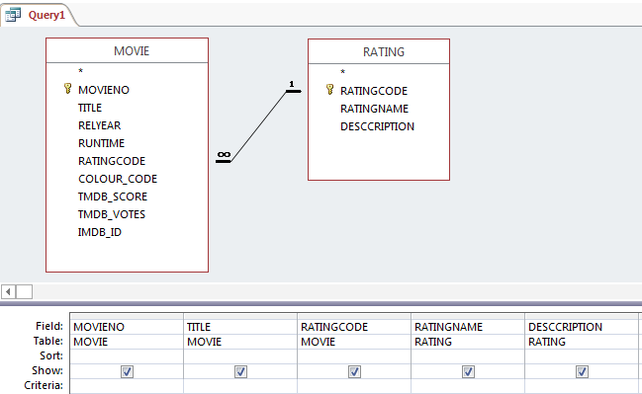
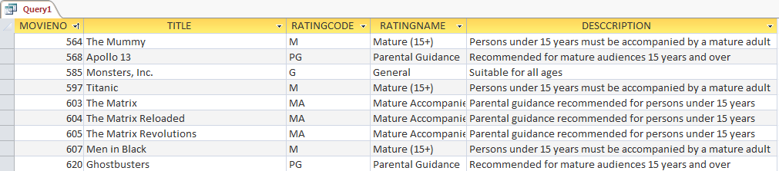
Query based on a two table relationship
Now design a new Query using both the Movie and Rating tables.
As you add the tables to the query, the relationship is shown.
This query has data from both tables. The query matches every FK value in the Movie table with a PK value in the Rating table.

Slide 12
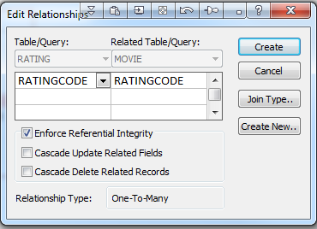
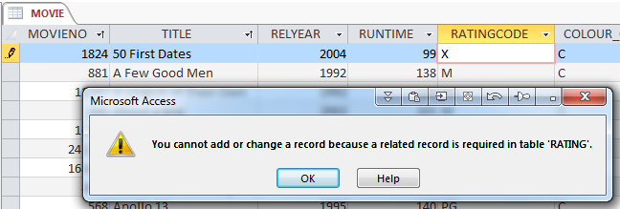
Referential Integrity
The option to Enforce Referential Integrity
is a constraint that the RDBMS performs to
only allow values in the movie.ratingcode
field that match an existing value in the
rating table
Entering a movie.ratingcode value of 'X'
would cause a referential integrity error.

Slide 13
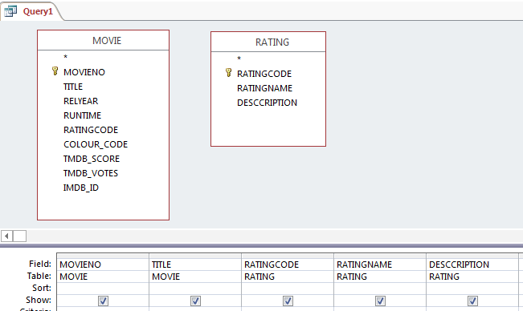
Be aware of unrelated tables
Imagine that you did not create the relationship between the Movie and Rating tables.
They are simply two unrelated tables.
When you create a query, the RDBMS does not know what these tables have in common.
There is no connection between the rating codes in the two tables (at least that's what the RDBMS thinks).

Slide 14
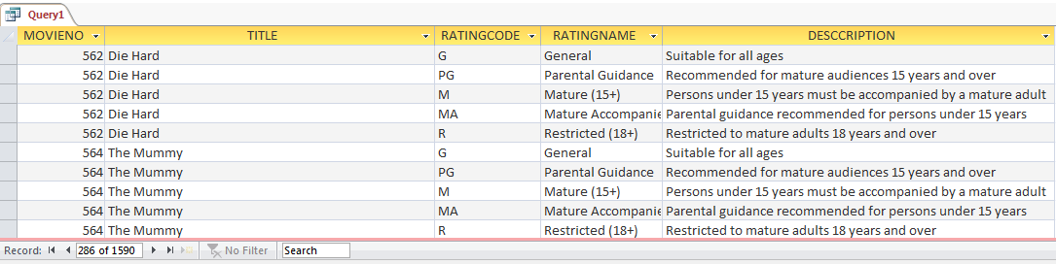
Be aware of Cartesian Products
If you run a query that uses data from both unrelated tables, then a 'cartesian product' is created. Every row in movie table matches every row in the ratings table.
318 movies * 5 ratings = 1590 rows! Utterly useless. Can be very slow to create. AVOID

Slide 15


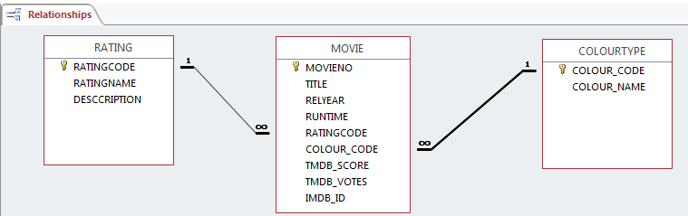
Movie Table / ColourType relationship
The Movie Table has a field called Colour_Code
Imagine that we create a table named ColourType.
This must be added to the Relationship Manager.
We have two Many to One relationships.

Slide 16
Actor data
The Movie Database requires information about actors.
  The following data about actors will be stored:
actorNo | firstname | surname | gender
72129 | Jennifer | Lawrence | F
51329 | Bradley | Cooper | M
1245 | Scarlett | Johansson | F
6968 | Hugh | Jackman | M

Slide 17
Actor data
So now we have data about Movies and Actors
The next obvious task is to nominate
the actors who appear in each movie
movieNo | title | relyear | runtime | ratingcode
70160 | The Hunger Games | 2012 | 142 | PG
82693 | Silver Linings Playbook | 2012 | 122 | MA
18785 | The Hangover | 2009 | 100 | MA
127585 | X-Men Days of Future Past | 2014 | 101 | PG
actorNo | firstname | surname | gender
72129 | Jennifer | Lawrence | F
51329 | Bradley | Cooper | M
1245 | Scarlett | Johansson | F
6968 | Hugh | Jackman | M

Slide 18

ACTOR, MOVIE relations
Bradley Cooper acted in the movie titled "Silver Linings Playbook"
I.e. actorNo 51329 acted in movieNo 82693
Jennifer Lawrence acted in the movie "Silver Linings Playbook"
I.e. actorNo 72129 acted in movieNo 82693
Jennifer Lawrence acted in the movie "The Hunger Games"
I.e. actorNo 72129 acted in movieNo 70160
We can store this information using these codes
Each row shown here represents one actor
cast into one movie
actorNo | movieNo
51329 | 82693
72129 | 82693
72129 | 70160

Slide 19
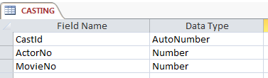
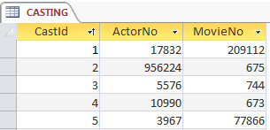
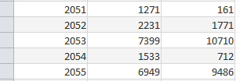
Casting table
We will create a table called Casting.
Each record in this table represents One Actor in One Movie
  The CastId is simply a auto generated number to give each row a unique identity (a primary key value).

Slide 20
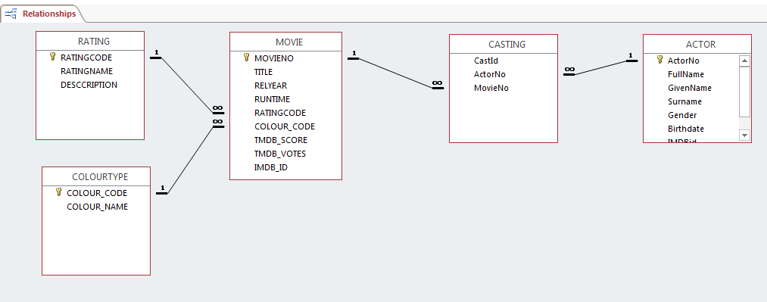
Relationship Diagram
This is an updated Relationship Diagram. It looks complicated.
However, it is simply a collection of multiple Many to One relationships.
Each relationship has a Foreign Key that references a Primary Key

Slide 21

Totals
Often, when users want to retrieve data from database tables,
they want to display some totals
How many employees do we have?
How many students are enrolled in INF10002?
How many staff of each gender do we have?
In the database world, this is often referred to as Aggregation
Typical total (or aggregation) functions are Count, Sum, Min, Max, Average

Slide 22

Count Values
Requirement: Count how many movies belong to each rating code
The answer should be in this format
  G 24
  PG 45
  M 121
  MA 83
  R 5
This query must display the Rating Code in column 1
This query must display the Count value in column 2

Slide 23
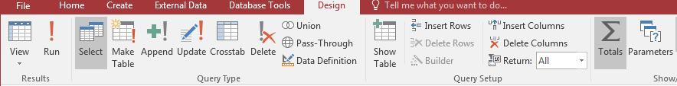
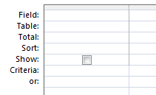

Totals
In Query Design Ribbon, click on the Totals icon
This adds a Total row to the
Query Design Grid

Slide 24
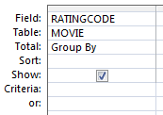

Totals
Add the field RatingCode to the Design Grid.
The Total operation says Group By.
This means that all of the RatingCodes in the
records will be Grouped.
G is a group
PG is a group
MA is a group…

Slide 25
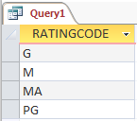
Totals
If we ran this query as it is, then we simply have a list of RatingCodes
that appear in the Movie table.
Not really useful.

Slide 26
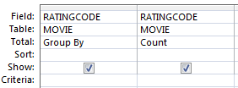
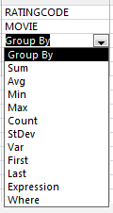
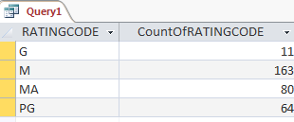

Totals
Add the field RatingCode for a second time
to the Design Grid.
This time change the type of Total
(or aggregation) you want to perform
In this example,
we will select
Count from the
pull down menu
Running the query
shows the count value
for each ratingcode.

Slide 27
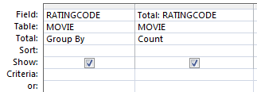
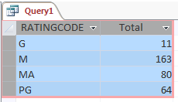
Changing the column heading
The column heading
CountOfRATINGCODE is not very
professional
Add a new column heading by placing
the new heading followed by a semi
colon : character prefix in front of the
field name
E.g. Total: RATINGCODE
Note: This technique applies to any column
heading in any query that you create

Slide 28
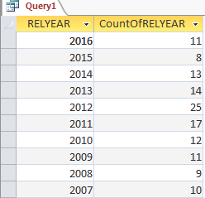
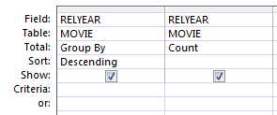

Another example of Group By
This is a similar example.
In this case, the query groups records by relyear.
For each relyear value, the total number of records
is counted.

Slide 29
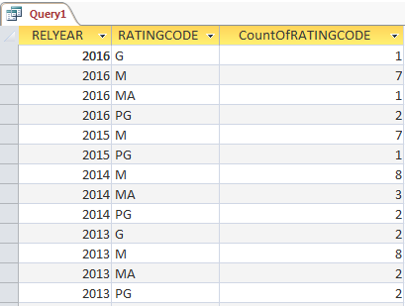
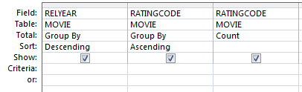
Two columns with Group By
Requirement: Count the number of movies in
each rating code for each release year.
The 1st column groups data by Relyear
The 2nd column groups data by RatingCode
within a Relyear
The 3rd column shows the count of movies for
each group combination.
2016 has 11 movies
Of those:
  7 have an M rating
  2 have a PG rating
  1 has a G rating
  1 has a MA rating

Slide 30
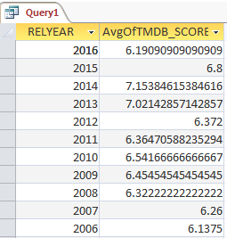
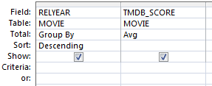
Two columns with Group By
This example demonstrates the AVG aggregation
function.
The average TMDB score is calculated for each year.

Slide 31
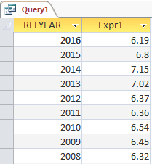
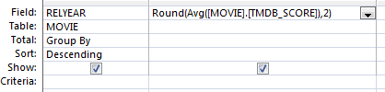


Two columns with Group By
The round the AVG calculation, we can use
the Round() function
Round() requires
the value that you want to round
the number of decimal places required
Write the expression in the Field cell:

Slide 32
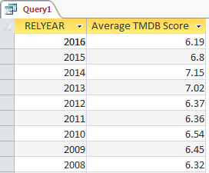

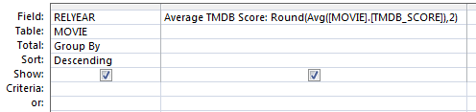
Two columns with Group By
Access automatically adds the column name prefix Expr1.
You can replace this prefix with any heading that you want

Slide 33
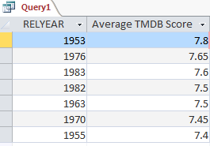
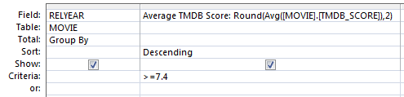
Two columns with Group By
With any of the aggregate functions you can
include a criteria that is applied to the totals
generated by the aggregate functions.
In this case, the query will only show totals where
the average TMDB score is greater than or
equal to 7.4

Slide 34
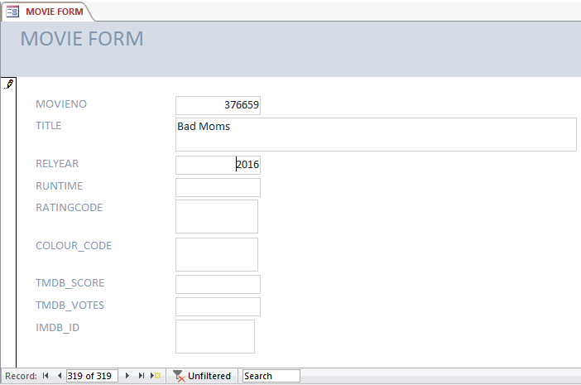
Access Forms
Access allows developers to quickly and easily create input forms
This form only shows one
record at a time.
Easy for the end-user to
focus on one item
Difficult to delete / make
changes to multiple records
(by mistake).

Slide 35
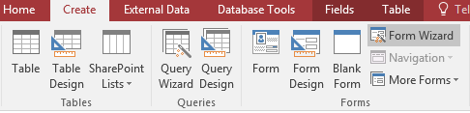
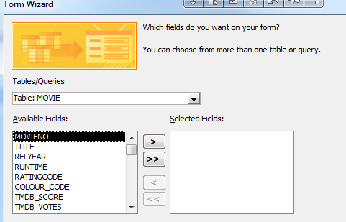
Creating a simple form
Select Form Wizard
Specify which columns are to
appear on the form.
(Some columns that are
calculated or populated at a
later date may not have to
appear)

Slide 36
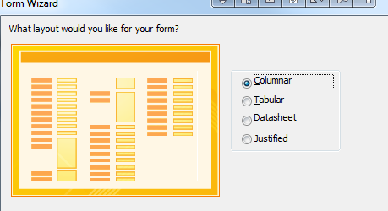
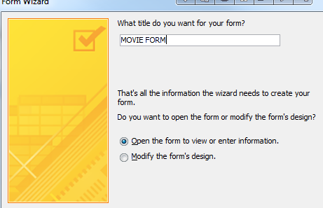
Creating a simple form
Choose the type of form required
Columnar allows you to place and resize
all fields
Finally, give the form a name e.g. Movie Form

Slide 37
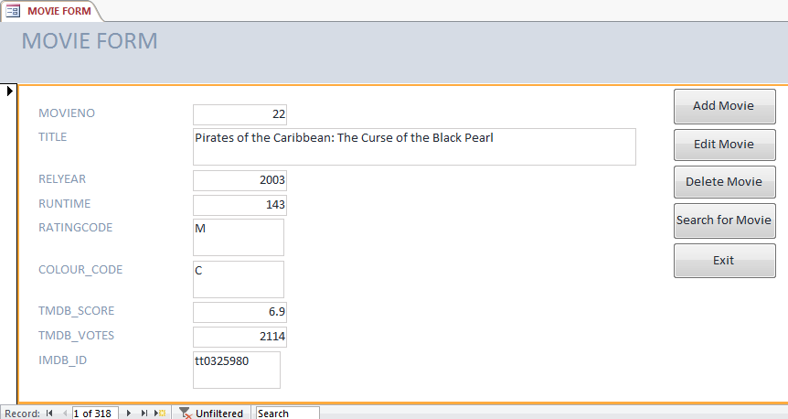
The Movie Database
In a more professional system, you could add a menu or buttons that make it easier to perform CRUD (create, read, update, delete) operations. You could add colour, text, images, hints etc.
Note:
Forms with buttons, menu, hints, validations, user defined error messages, sub forms, etc. are not 'simple to create'.
There are many books, tutorials & discussion boards that cover these topics.

Slide 38
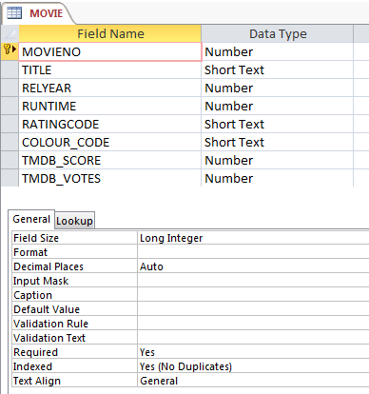

Indexes
You may have noticed that whenever
we created a Primary Key column,
the field property panel populated
the property Indexed.
What is an index?
How can it assist us?

Slide 39
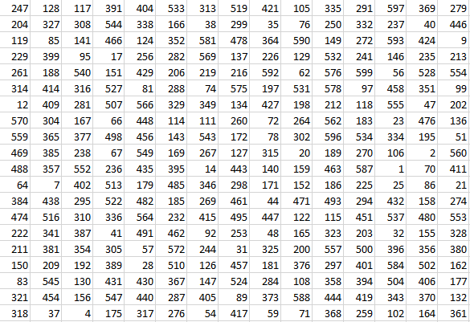
Indexes
Imagine that this is a
list of employee ids.
Do these employees
exist?
  212
  61
It is hard & slow work
to sequentially view
every value.

Slide 40
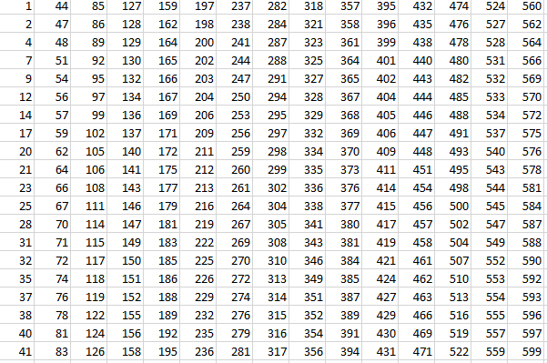
Indexes
Do these employees
exist?
  91
  502
The search is much
easier when the
values are stored in
numeric sequence.

Slide 41
Indexes
If the index did not exist, Access would have to view each record in the employee table sequentially to find a matching employee id.
With 100,000 records, that could be a long time. (Well a second or two).
If there were 10 million rows, the delay would increase.
The more rows we have…. the slower the sequential search.

Slide 42
Indexes
Suppose we create an index on the Employee Id of the employee table
The table currently has 100,000 records.
Access creates an index which stores
  The index value (the employee id)
  The location of the record within the database
When Access searches for an employee id
  It quickly finds the employee id in the index (if it exists)
  Gets the location of the record
  Retrieves the record

Slide 43
Primary Key Index
Whenever you create a Primary key, Access automatically creates a Primary Key index.
If you enter a Primary Key value that has already been used by another record, Access displays a Duplicate Primary Key error message.
One of the reasons Access can determine if there is a duplicate primary key so quickly is that the field is indexed. Finding a matching key value id simple and quick.

Slide 44
Sequential Record Access
Read each record one by one from the beginning of the table until the
required record is found.
  The DBMS may have to evaluate 50,000 separate records.
    Assume that each record is very large.
    Assume each evaluation requires one disk I/O. *
    Disk I/O is the slowest computer activity.
  On average, a search for an employee will require 25,000 disk I/Os.
  * - In reality, a DBMS will read records as blocks of data (e.g. 2K).
  Therefore many records can be read into memory
  with a single disk I/O

Slide 45



Inserting data into a simple Index
When a table has a Primary Key, an Index based on that Primary Key is automatically created.
As each row is added, the DBMS automatically inserts the search key and the row location information into the index file.
Insert 1st row. Employee 109
A row is inserted into the Employee table
The search key and row location is added to the PK index
Table
Index
RowLoc | EmpId | FirstName | Surname | Dept
1 | 109 | Bronwyn | Harris | Mktg
Key | RowLoc
109 | 1

Slide 46




Inserting data into a simple Index
Insert 2nd row. Employee 13
A row is inserted into the Employee table.
The row is added to the table.
The search key and row location is added to the PK index
The PK Index is automatically maintained in PK sequence
Table
Index
RowLoc | EmpId | FirstName | Surname | Dept
1 | 109 | Bronwyn | Harris | Mktg
2 | 13 | Dave | Rigg | IT
Key | RowLoc
13 | 2
109 | 1

Slide 47
Inserting data into a simple Index
Insert 3rd row. Employee 27
A row is inserted into the Employee table.
The row is added to the table.
The search key and row location is added to the PK index
The PK Index is automatically maintained in PK sequence
Table
Index
RowLoc | EmpId | FirstName | Surname | Dept
1 | 109 | Bronwyn | Harris | Mktg
2 | 13 | Dave | Rigg | IT
3 | 27 | Debra | Shaddock | Admin
Key | RowLoc
13 | 2
27 | 3
109 | 1

Slide 48
The Index
Obviously, the Index is much smaller than the table data
Searching the index is quicker than sequentially searching the table
The Index is in key sequence. This makes searching quick.
Key | RowLoc
13 | 2
23 | 13
27 | 3
47 | 12
56 | 10
87 | 8
88 | 4
109 | 1
136 | 7
145 | 6
215 | 9
289 | 11
340 | 5
RowLoc | EmpId | FirstName | Surname | Dept
1 | 109 | Bronwyn | Harris | Mktg
2 | 13 | Dave | Rigg | IT
3 | 112 | Debra | Shaddock | Admin
4 | 88 | Jenny | Black | Mktg
5 | 340 | Karen | Charles | Admin
6 | 145 | Lisa | Church | IT
7 | 136 | Naomi | Allen | Admin
8 | 87 | Nick | Taylor | Admin
9 | 215 | Peter | Mills | Mktg
10 | 56 | Steve | Avery | IT
11 | 289 | Susan | Armstrong | Admin
12 | 47 | Terry | Ymer | Admin
13 | 23 | Tim | Wade | Admin

Slide 49
Searching the Index
Locating the row for employee 289 is quicker using the index.
A RDBMS may use a search method on the index such as a Binary Search
  A Binary Search continues to split the index in half until a match is/is not found
Start at the middle^{th} position
The value being searched for is either
  The current key value OR
  A key value higher in the list OR
  A key value lower in the list
At least half of the key values are eliminated.
The eliminated values do not need to be searched
Key | RowLoc
13 | 2
23 | 13
27 | 3
47 | 12
56 | 10
87 | 8
88 | 4
109 | 1
136 | 7
145 | 6
215 | 9
289 | 11
340 | 5

Slide 50
Searching the Index
Of the remaining key values,
examine the new middle^{th} position
The value being searched for is either
  The current key value OR
  A key value higher in the list OR
  A key value lower in the list OR
Again, half of the keys are eliminated.
Key | RowLoc
13 | 2
23 | 13
27 | 3
47 | 12
56 | 10
87 | 8
88 | 4
109 | 1
136 | 7
145 | 6
215 | 9
289 | 11
340 | 5
eliminated

Slide 51
Searching the Index
Once a match has been found, the RDBMS can quickly retrieve the appropriate record
Key | RowLoc
13 | 2
23 | 13
27 | 3
47 | 12
56 | 10
87 | 8
88 | 4
109 | 1
136 | 7
145 | 6
215 | 9
289 | 11
340 | 5
RowLoc | EmpId | FirstName | Surname | Dept
1 | 109 | Bronwyn | Harris | Mktg
2 | 13 | Dave | Rigg | IT
3 | 112 | Debra | Shaddock | Admin
4 | 88 | Jenny | Black | Mktg
5 | 340 | Karen | Charles | Admin
6 | 145 | Lisa | Church | IT
7 | 136 | Naomi | Allen | Admin
8 | 87 | Nick | Taylor | Admin
9 | 215 | Peter | Mills | Mktg
10 | 56 | Steve | Avery | IT
11 | 289 | Susan | Armstrong | Admin
12 | 47 | Terry | Ymer | Admin
13 | 23 | Tim | Wade | Admin

Slide 52
Searching the Index
Imagine that you want to publish all 100,000 employees in Employee ID sequence
The database will jump from location to location to retrieve
the data in the correct sequence.
Employee 4 is at location 97,491
Employee 5 is at location 18
Employee 7 is at location 43,292 …
The RDBMS is doing a large amount of work
If the table was not indexed:
How would the RDBMS find the employee with the lowest ID?
How would the RDBMS find the next lowest ID? …
It would be very, very slow.
(In reality, RDBMS are very quick at processing records. If a table only has a few thousand rows, the speed of using an index or using a sequential search will almost be identical.)
Key | RowLoc
4 | 97,491
5 | 18
7 | 43,292
14 | 6,390
17 | 431
18 | 72,103
23 | 83,242
27 | 12,378
36 | 70,231
45 | 383
58 | 2,834
79 | 27,844
124 | 84,234

Slide 53
Advantages of using an Index
Using an index is a quick method to locate rows.
Large portions of the index (or the entire index) may be read into the computer's memory at once before searching for rows in a table.
Fewer disk I/Os (input/outputs – the slowest function of a computer).
  This reduces the number of disk I/Os required to read table rows
  This speeds up retrieval time
In the above example, finding employee 289 took 2 disk I/Os.
  One to read the index into RAM
  One to read the 11th row in the table.

Slide 54
Additional information
  A binary search is only one type of search method available to a DBMS
      In reality, far more complex indexing options exist
      Most RDBMS may have multiple options / methods of indexing tables
        The option selected often depends on an understanding of the data values that will be stored.
  It is not possible to display the contents of an index
      Indexes may be stored in a non-human readable format and/or a compressed format to reduce their size and improve search speeds

Slide 55
Additional information
  The index does not contain a record number.
    The record number we see in the datasheet doesn't really exist!
    Fred Blogs data may be stored in Record 3.
    If Record 1 & 2 are deleted, then Fred becomes Record 1.
    So the Record Number is a poor way of identifying a record
    (That's one reason we use Primary Keys).
  Instead, the RDBMS uses a physical address on disk to specify the location of the record. This is the value of RowLoc in the previous slides
    In Oracle RDBMS the address is something like AAAYUzAAEAABIjLAAJ
    Access makes it almost impossible for you to view the physical address.
  Students studying Database Systems INF20010/60014 learn more
  about this topic in the Data Warehousing module.

Slide 56

Index Creation
It is relatively easy to create an Index.
This is automatic for Primary Keys.
Some indexes can have duplicate value.
Consider a surname field:
  Surname is not a good Primary Key (too many people share a surname)
  However it makes sense to create an index on surname
    A surname is often searched for or reports are required in surname sequence
Using a binary search (or similar) will still speed up finding the 1st row with a match surname value

Slide 57
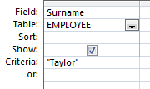
SQL: Multiple indexes (indices)
Suppose we want to execute this query
How many rows have to be sequentially
read if the table has 100,000 rows
(with no index on surname) to find a match?
  On average 50,000 reads
How many reads are required if there is an index based on Surname? Far fewer!
  One read to load index into RAM. Perform binary search.
  One read to retrieve the first matching row
  Subsequent reads for any duplicate surnames
Key | RecNo
Allen | 7
Allen | 14
Armstrong | 11
Atkins | 17
Avery | 10
Black | 4
Black | 16
Charles | 5
Cherry | 18
Church | 6
Harris | 1
Harris | 15
Mills | 9
Rigg | 2
Rogers | 19
Taylor | 3
Taylor | 8
Wade | 13
Ymer | 12

Slide 58
Indexes speed up report generation
There are many IT database stories involving reports that
  Use many tables with Foreign Key lookups
  Involve millions or billions of database records
  Take hours to produce
A daily report that takes more than 10 hours to run may be next to useless.
  Such reports do exist!
Creating indexes on fields central to the report have often reduced report generation time from many hours to a few minutes.

Slide 59
The cost of creating Indexes
Why not index every field?:
  Disk Space - a minor consideration. Disk space is cheap.
  Update-Time - a major consideration.
    When records in a table are inserted, changed, deleted:
      Every index must be updated
        so that the index remains in key sequence
      Each change takes time to complete
Too many indexes can make unacceptable delays
    Imagine each Unit that you enrol in, causes a few seconds delay
      As all of the indexes are updated
    Imagine each time Australia Census data is recorded there is a delay as all indexes are updated
      Users will not be happy

Slide 60
Deletion / Recreation of Indexes?
Database management in an organisation often involves compromises
  An organisation may run a once-a-week report.
  The report requires many indexes to run acceptably
  It may make sense to
  Create the indexes prior to running the report
      it make take a few minutes for each index to be created
  Run the report
  Drop the indexes
Often such tasks can be scheduled to automatically take place

Slide 61
An multi-level index
Key
Index Seg |  | Row
1 | 13 | 2
 | 23 | 13
 | 45 | 14
 | 47 | 12
 | 56 | 10
2 | 85 | 15
 | 87 | 8
 | 88 | 4
 | 109 | 17
 | 112 | 3
3 | 136 | 7
 | 145 | 6
 | 171 | 1
 | 201 | 16
 | 215 | 9
4 | 289 | 11
 | 291 | 23…
Some large indexes may be split into smaller index segments.
An index entry is created for all of the segments.
It's an index of indexes.
Task: Find employee 145
Row | EmpId | FirstName
1 | 171 | Bronwyn
2 | 13 | Dave
3 | 112 | Debra
4 | 88 | Jenny
5 | 340 | Karen
6 | 145 | Lisa
7 | 136 | Naomi
8 | 87 | Nick
9 | 215 | Peter
10 | 56 | Steve
11 | 289 | Susan
12 | 47 | Terry
13 | 23 | Tim
14 | 45 | Simon
15 | 85 | Bruce
16 | 201 | Debra
17 | 109 | Belinda
18 | 333 | Michael
19 | 401 | Dave
LastKey | IndexSeg
56 | 1
112 | 2
215 | 3
340 | 4

Slide 62
DBMS Optimisers
DBMS systems have optimisers.
Optimisers are designed to decide the quickest and most efficient way of accessing data.
Multiple indexes may exist, but it is the DBMS optimiser that decides if it is of benefit to use the indexes.
Image we have a table with a small number of rows.
We have indexes based on the Employee Id and Surname.
Imagine that it only takes one or two reads to load the entire table into memory,
It may be quicker to read/load all rows into memory
compared to reading / loading the Indexes into memory and then retrieving the appropriate row(s)
Optimisers attempt to reduce the time taken to process the query.

